Slide 1
Binary Trees
Unit 4
CC4 Data Structures and Algorithms
Lovely Jenn A. Reformado

Slide 2
Table of Contents
Introduction to trees
Introduction to the binary tree

Slide 3
Introduction to Trees
What is a tree? | Why trees? | Concepts on trees | Types of trees

Slide 4
What is a Tree?
Hierarchical data structure that is similar to a structure of a graph – nodes connected to edges
Used for data that has no key or reference value
Two main parts:
Node – Entity that contains a key or value
Edge – Link between any two nodes
Two types of nodes:
Parent – Node containing other nodes
Child – Node that is under another node
Notes:
Why do we use trees?

Slide 5
Why Trees?
Storing data sequentially:
In most data structures, it requires the data to be stored sequentially
The more data there is, the time complexity increases
Higher time complexity = not recommended
Would also require to have the smaller and largest data stored specifically
Organizing data in a sequential manner would be faster and retain its complexity
Notes:
It helps in storing data sequentially. Because the more data that we store the more time it consumes so we use tree as it is faster and it retains its complexity

Slide 6
Why Trees?
Applications of Trees
Binary search tree – Quickly check whether an element is present in a set or not
Heap sort – Or other examples of sorting algorithms
Tries – Variation of trees that store routing information
B-Trees and T-Trees – Used for storing data and databasing
Syntax Tree – Validation of a syntax in code, particularly on arrangement
Notes:
BST is a special type of binary tree where the nodes are organized in a way that allows for efficient searching and insertion.

Slide 7
Concepts on Trees
Nodes, root, and edges
Terms in identifying nodes
Node height, node depth, and tree height
Degree of node and forest

Slide 8
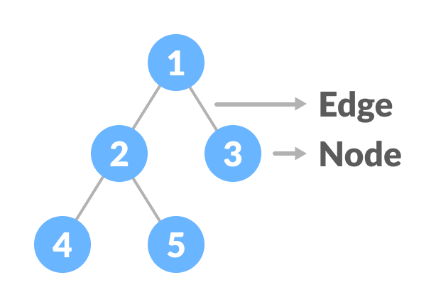
Concepts on Trees
Nodes, Root, and Edges
Node – Entity that contains a key or value
Root – topmost node of a tree; must not be a child node
Edge – Link between nodes

Slide 9
Concepts on Trees
Terms in Identifying Nodes
Child – General term used for a node that has a parent node
Subtree – Child node that is also a parent node
External / Leaf – Child node that does not have any child nodes under it

Slide 10
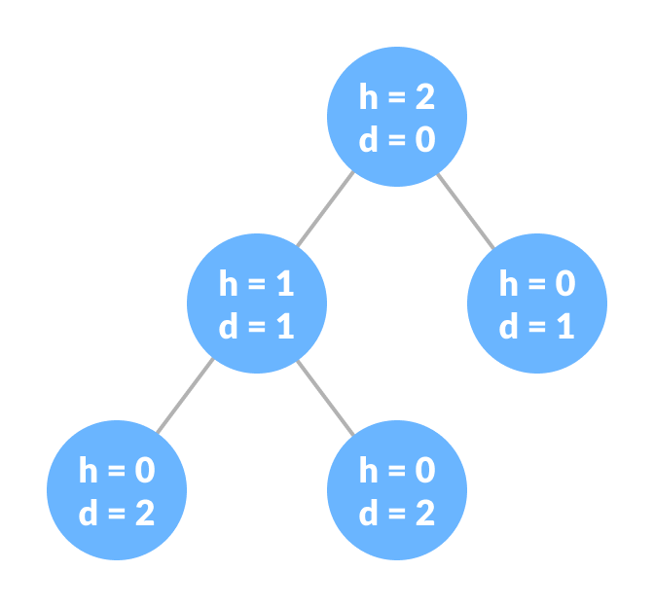
Concepts on Trees
Node Height, Node Depth, and Tree Height
Node Height – Number of edges from the node to the deepest leaf (i.e. longest path of nodes)
Node Depth – Number of edges from the root to the node
Tree Height – Height of root node

Slide 11
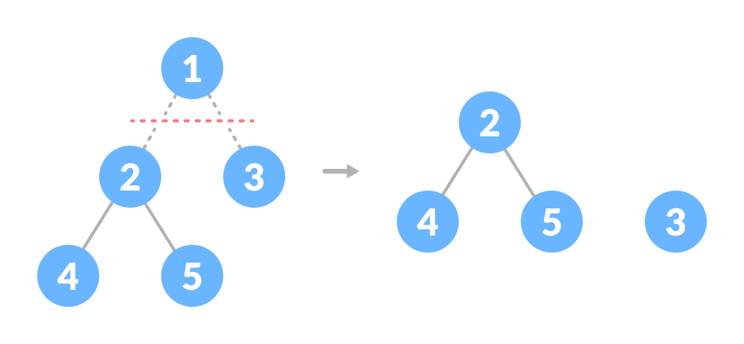
Concepts on Trees
Degree of Node and Forest
Degree of a Node – Total number of branches of a node
Forest – Collection of disjoint trees cut from the root
Notes:
Node 1 has a degree of 2 because it has two children (Nodes 2 and 3).
Node 2 has a degree of 2 because it has two children (Nodes 4 and 5).
Node 3 has a degree of 0 because it has no children (it's a leaf node).
Node 4 has a degree of 0 because it has no children (it's a leaf node).
Node 5 has a degree of 0 because it has no children (it's a leaf node).

Slide 12
Types of Trees
Binary
Each parent node can have at most two children
Binary Search
Application of binary trees that can quickly maintain a sorted list of numbers
AVL (Adelson-Velsky and Landis)
Self-balancing binary search tree which contains extra information for balancing
B-Tree
Self-balancing tree where each node can contain more than one key and can have more than two children nodes

Slide 13
Introduction to Binary Trees
What is a binary tree? | Types of binary trees | What is a binary search tree?

Slide 14
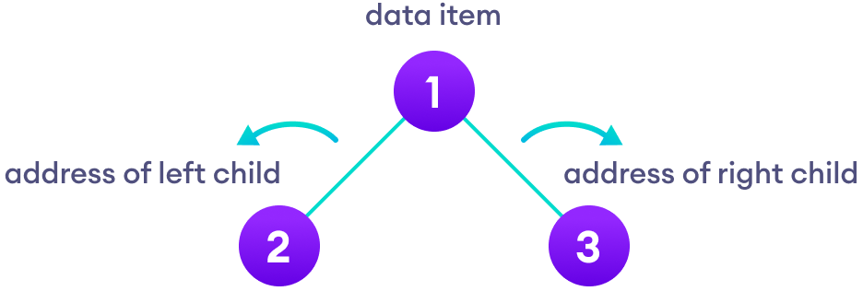
What is a Binary Tree?
Data structure where each parent node can have at most two children
There are three nodes: data item, left child, and right child
Notes:
Data item/parent node

Slide 15
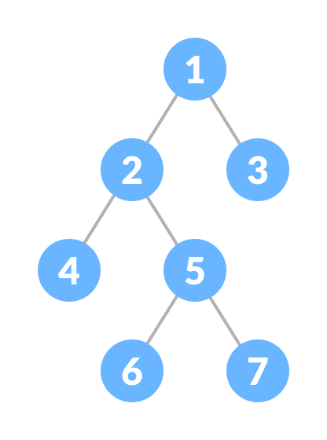
Types of Binary Trees
Full Binary Tree
Every parent node/internal node has either two or no children
There must be no parent node that only has one child
Notes:
either 0 or 2 children

Slide 16
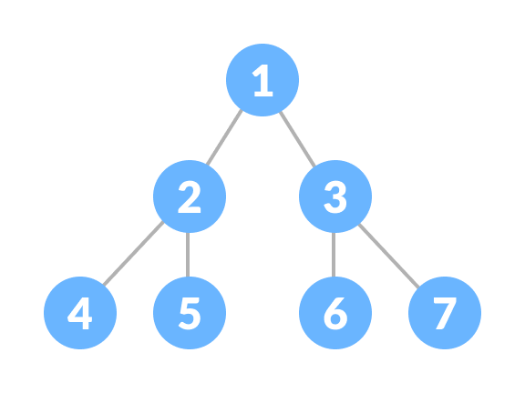
Types of Binary Trees
Perfect Binary Tree
Every internal node has exactly two child nodes
All of the leaf nodes are at the same level
Each side (left / right) must have the exact same number of nodes

Slide 17
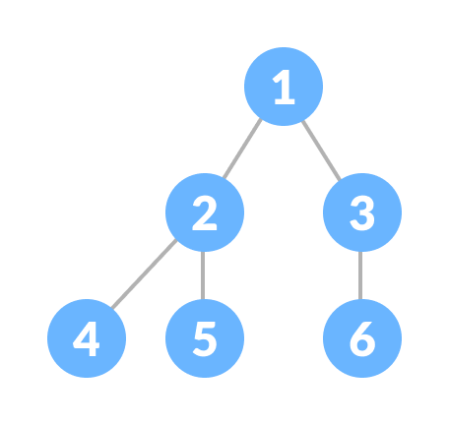
Types of Binary Trees
Complete Binary Tree
Similar to a full binary tree, but:
Every level must be completely filled
All leaf elements must lean towards the left
The last leaf element might not have a right sibling

Slide 18
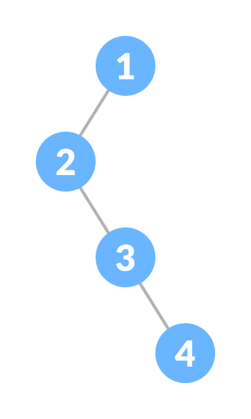
Types of Binary Trees
Degenerate / Pathological Binary Tree
Tree having a single child either left or right
Every parent node must have only one child node

Slide 19
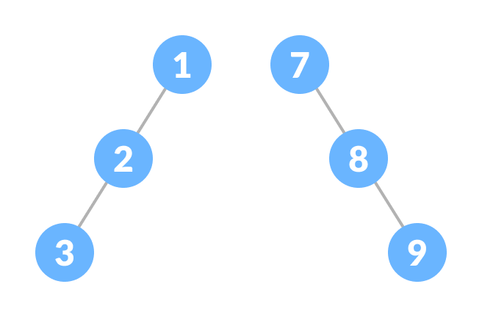
Types of Binary Trees
Skewed Binary Tree
Tree is either dominated by left or right nodes
Two types:
Left-skewed binary tree
Right-skewed binary tree

Slide 20
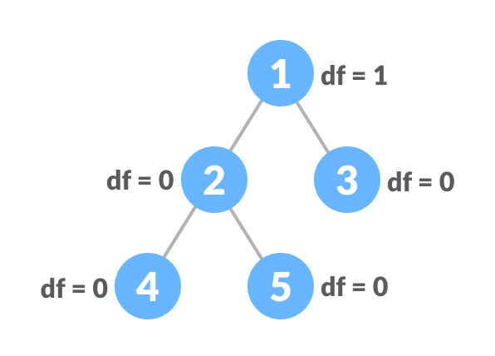
Types of Binary Trees
Balanced Binary Tree
Difference between the height of the left and the right subtree for each node is 0 or 1
Notes:
Lest start bottom up
Node 4 and 5 doesn’t have any child node so 0-0 is zero
Node 2 has two child node 1-1 is 0
Node 3 has no child so 0
Node 1 if you check the left tree height is 2, the right tree base it at levels, node 3 height is considered as 1 so 2-1 is 1.

Slide 21
What is a Binary Search Tree?
Data structure that quickly allows us to maintain a sorted list of numbers
Based off the binary tree, but:
All nodes of left subtree are less than the root node
All nodes of right subtree are more than the root node
Both subtrees of each node are also BSTs i.e. they have the above two properties

Slide 22
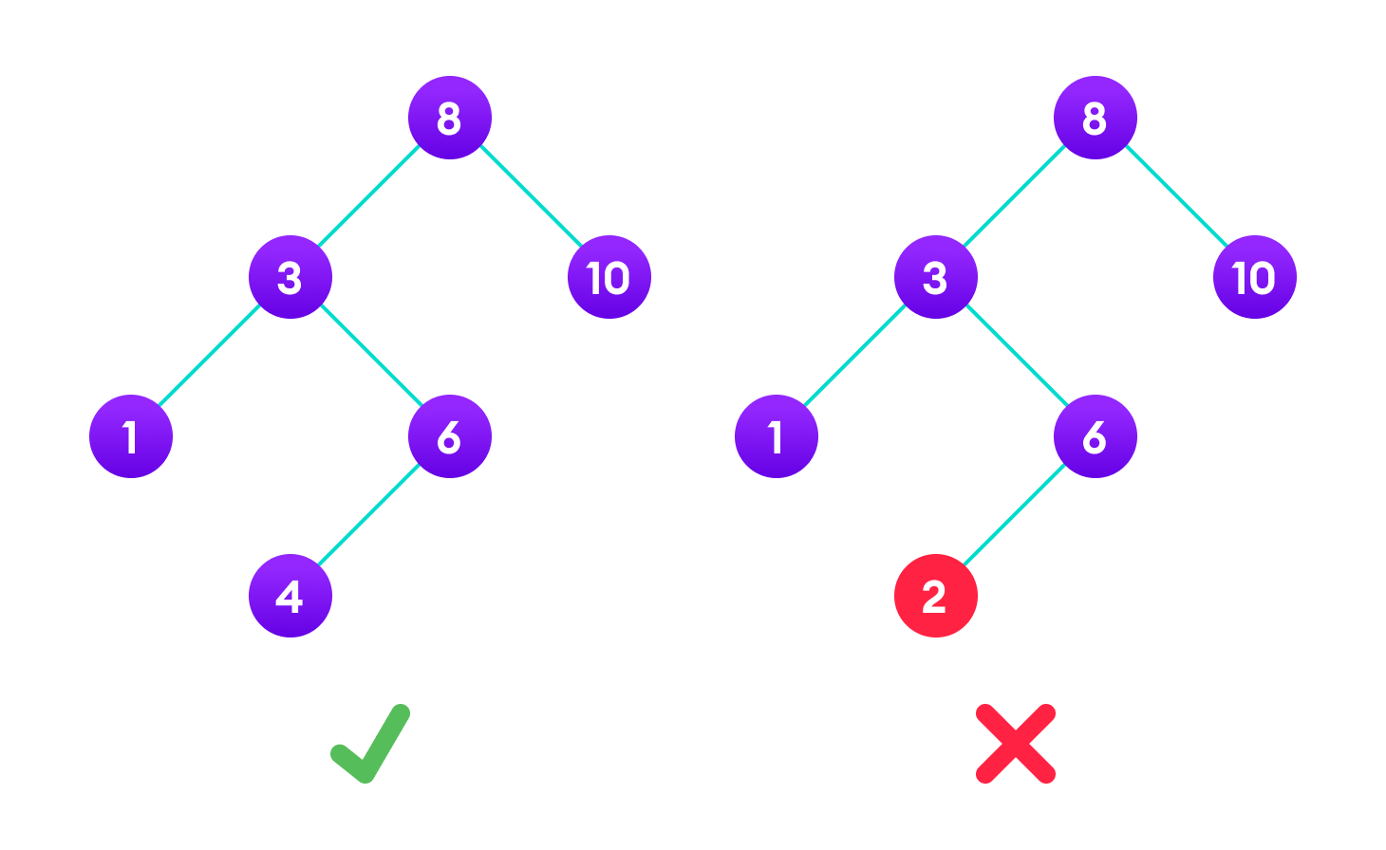
What is a Binary Search Tree?
Notes:
We follow an algorithm

